Slide 1


THIS IS YOUR PRESENTATION (OR SLIDEDOC) TITLE

Slide 2
Roadmap
Introduction
Problem Statement
Scope
Proposed System
Design
Implementation

Slide 3
INTRO.
WHY ?
WHAT ?
HOW ?

Slide 4
Problem Statement

Slide 5
This solution will primarily have a couple of features. The first feature would be to use Image-processing to analyze the images uploaded by the user. The second feature will rate the quality of images of the user and give them suggestions to click it better. These images will be used in the e-commerce store we'll create for the user and a good quality image can increase the chances of conversion.

Slide 6
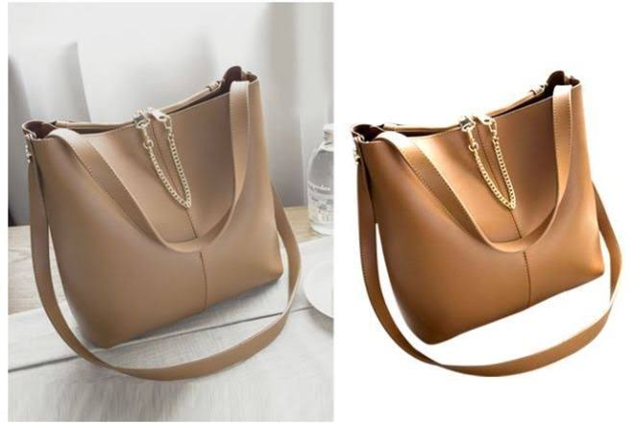
Leading businesses in online visual merchandising say that "The quality of the initial image dictates the quality of the end product."
Studies also suggest that the brain processes and remembers visual data a whole lot more than text.
As in, customers who browse products on websites, wanna see products they are considering for purchase represented by the highest quality image possible.
For example if we look at this picture
When the image becomes clutter free, the sole focus is on the product without any distracting elements.

Slide 7
Existing Systems

Slide 8
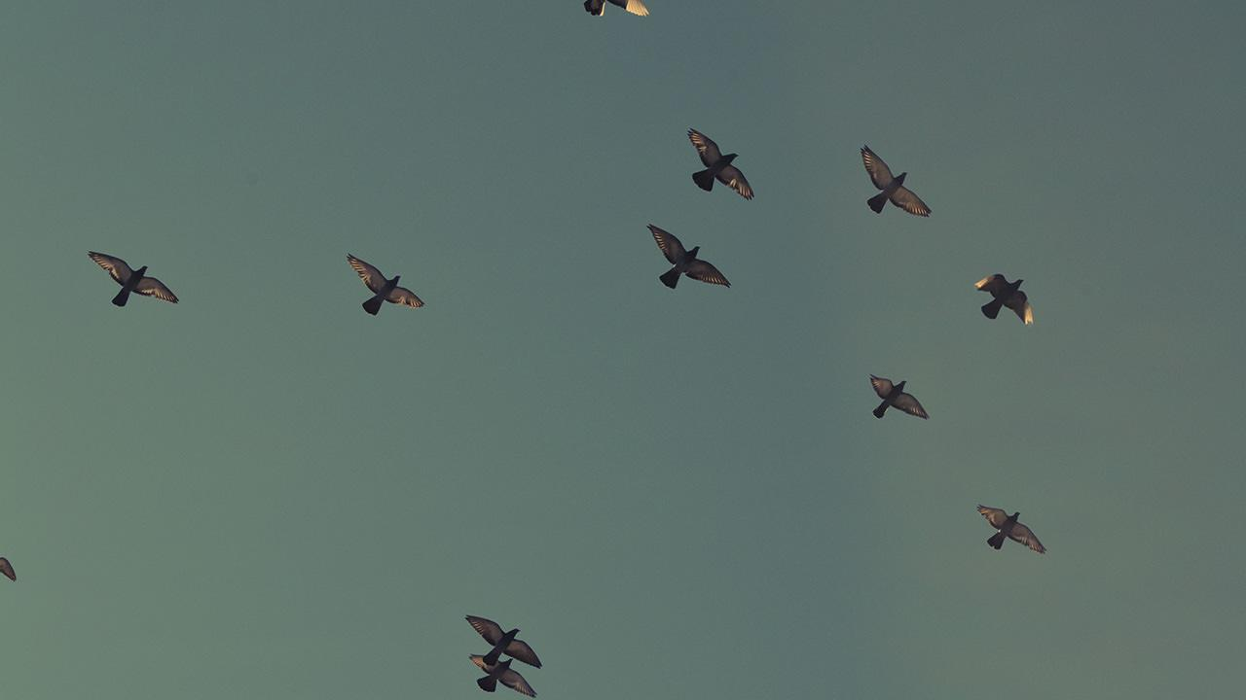
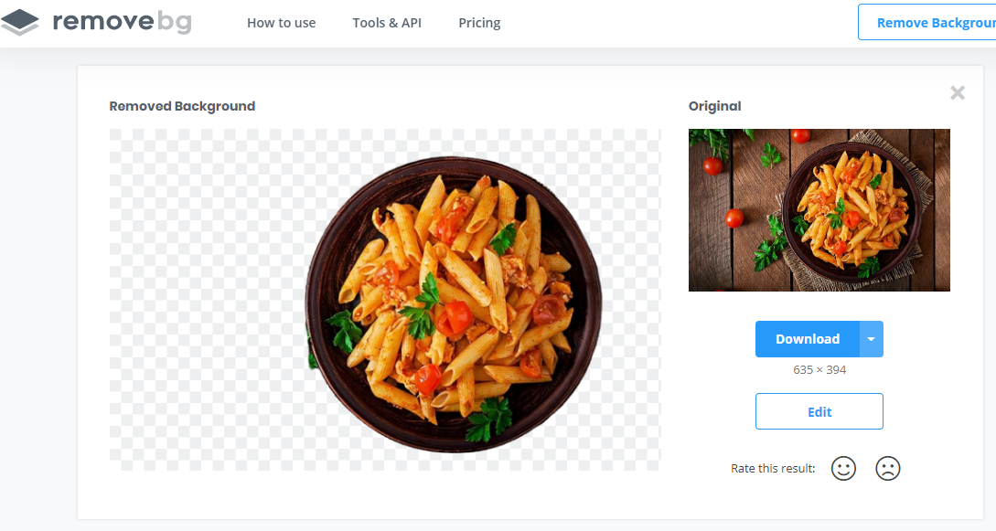
1.
Remove.bg

Slide 9
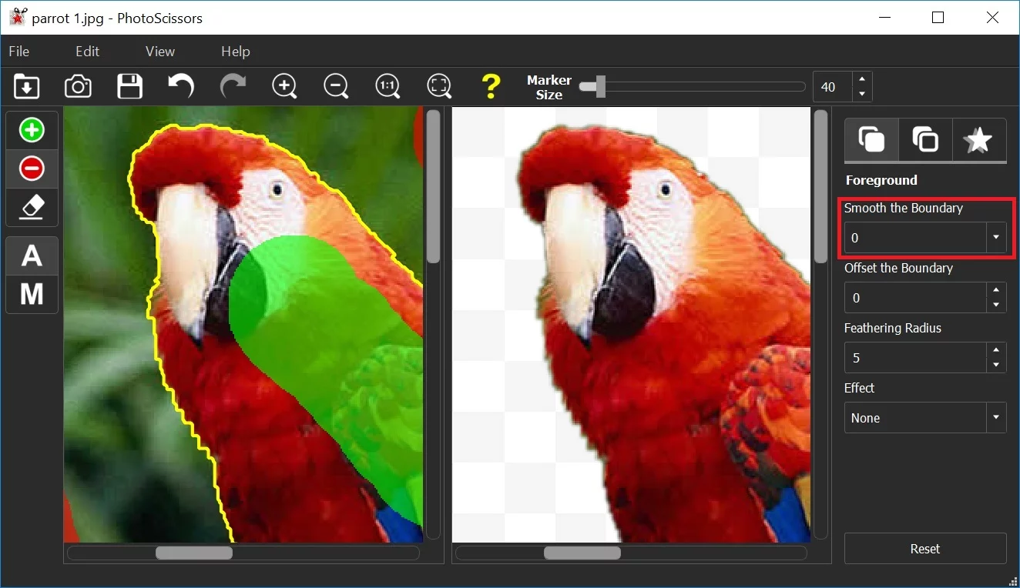
2.
Teorex PhotoScissors

Slide 10
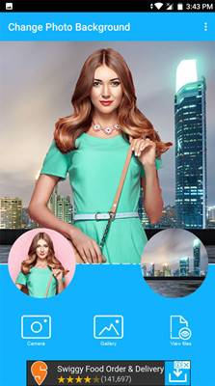
3.
Change Photo
Background

Slide 11
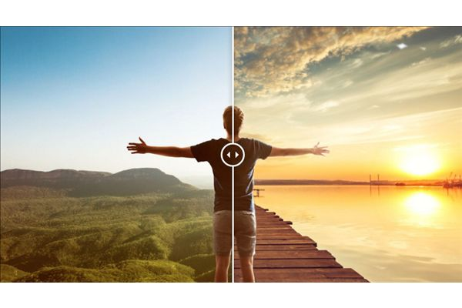
4.
Photoshop

Slide 12
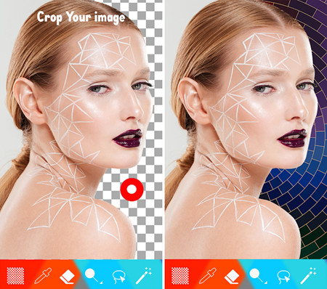
5.
Auto Background Eraser + Changer

Slide 13
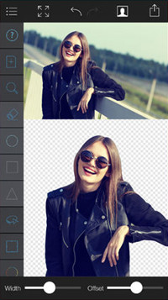
6.
Background Eraser -Pic Editor

Slide 14
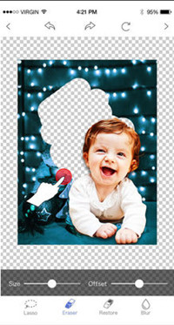
7.
Cut & Paste Photo Blender

Slide 15
Gaussian Mixture Model

Slide 16
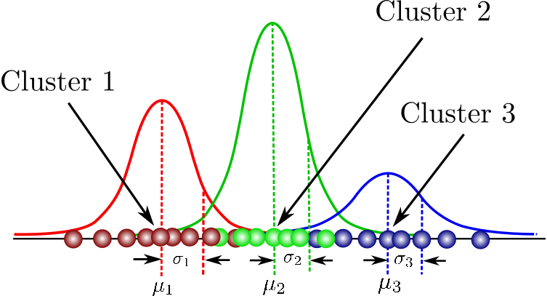

Slide 17
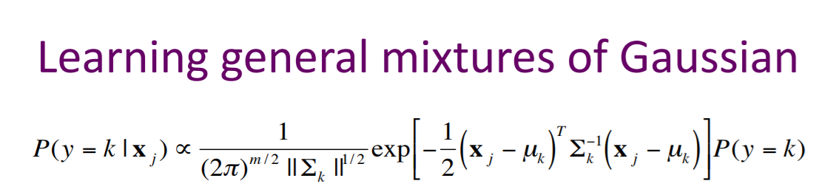
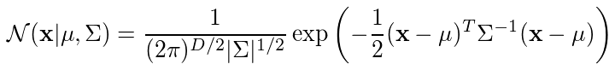

Slide 18
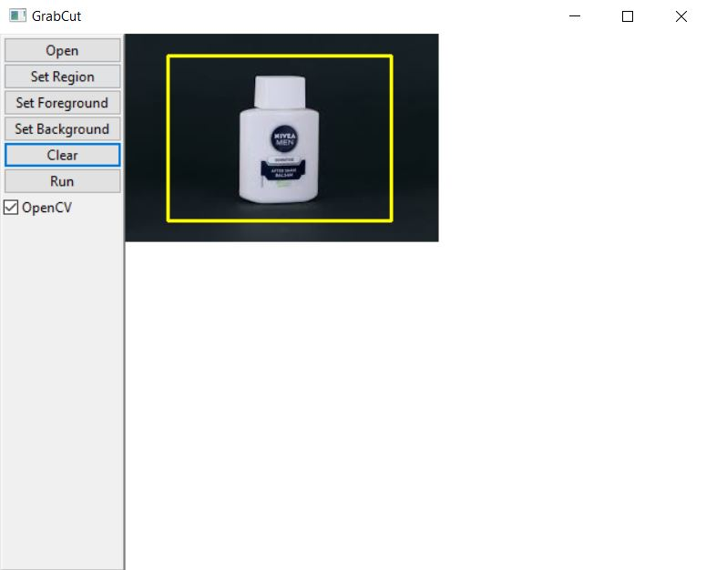
Thank You

Slide 19
Proposed System
Quality
Speed
Our
Product
Usability
Creativity

Slide 20
In our system we first take in the images of the products from the client side and then using image processing we extract the foreground.
The algorithm used is the GrabCut algorithm. In this there are two Gaussian models created, one for the foreground and one for the background.

Slide 21
Then these extracted images are passed through the image rating algorithm IMA.
IMA uses object recognition which is used to categorised the image for rating
There are two ways for rating the images
Reference Rating
Non Reference Rating (Blind)

Slide 22
Reference Rating
Peak Signal to noise ratio (PSNR)
Similar Structure (SSIM)
Blind Rating

Slide 23
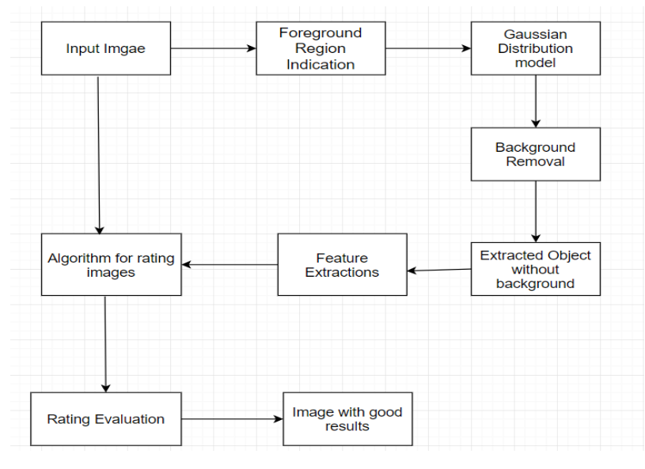
Design

Slide 24
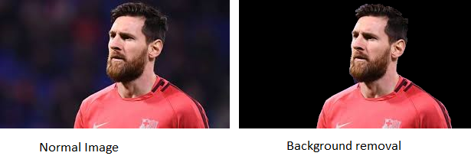
Output

Slide 25
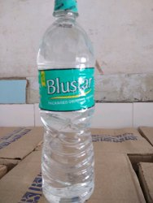
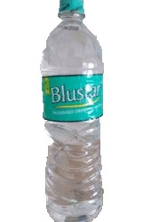
Assessment Score: 4.680
Assessment Score: 4.889

Slide 26
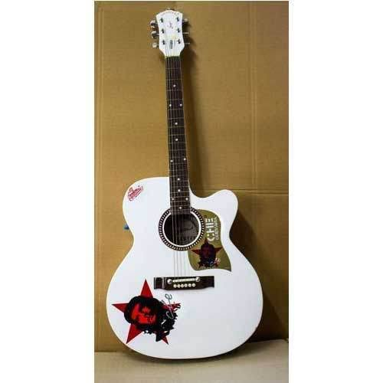
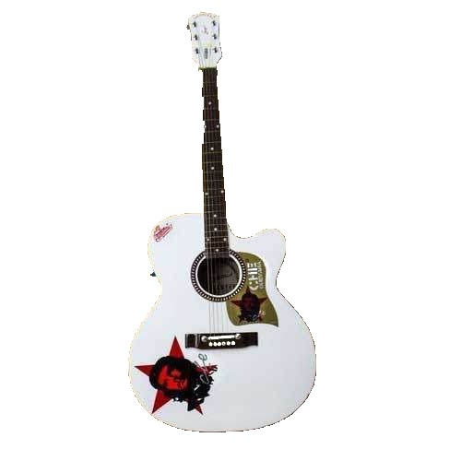
Assessment Score: 4.920
Assessment Score 4.929

Slide 27
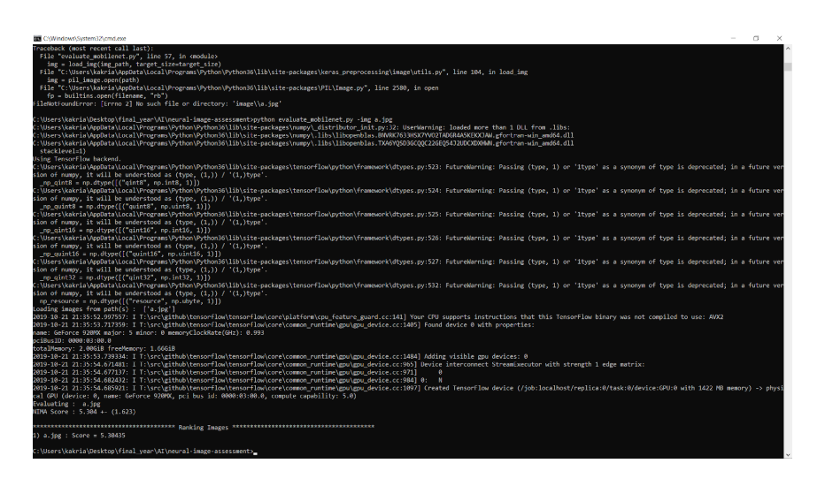

Slide 28
Further Use
Recommendation
Automation
Social Media Influence

Slide 29
Conclusion.
Thus, We have done image processing and made an artificial intelligence rating system for this term. The motive is to improve the visualisation of e-commerce products and result in better conversion to sales. We have focused on image processing, specifically, foreground extraction of the products and further rating the images to give suggestions on how the images could have obtained even higher ratings.

Slide 30
Credits
Special thanks to -
Ms. Sandhya Pati

Slide 31
Thank You ✌

